Slide 1
Lecture 6
Learning Outcomes:
Draw the 6 atoms in the peptide plane.
Apply the Boltzmann Distribution equation to calculate the probability of a conformation of known energy relative to the ground state.
Identify bonds corresponding to backbone torsion angles phi, psi and omega
The Ramachandran Plot
      Explain what information is displayed in the Ramachandran Plot
      Locate the allowed regions for Gly and for Pro vs. for all other AA
      Draw the general regions corresponding to alpha-helix and beta-sheet
      Understand the meaning of calculated vs.“real protein” Ramachandran Plot
      Explain why the Ramachandran Plots for folded and unfolded proteins look similar!
Secondary structures
Identify and draw cis and trans isomers of the peptide bond
Draw and recognize the backbone hydrogen bonding and key features of the alpha-helix
Draw and recognize the backbone hydrogen bonding and key features of the beta-sheet

Slide 2
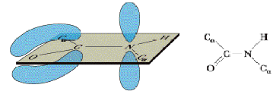
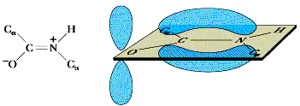
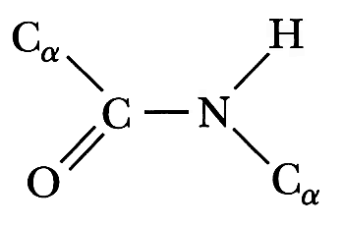
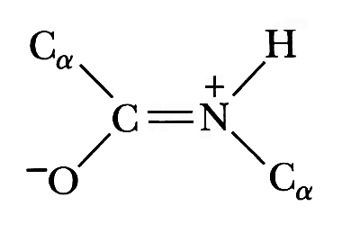

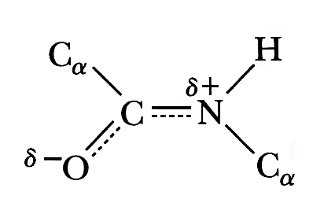
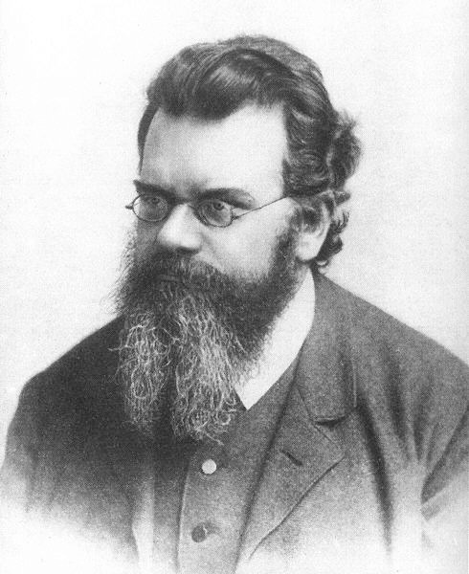
Different type of construction rule: peptide bond constraints
Specific bond angles and lengths result
Free rotation
X
Free
rotation
Shared double bond
6 atoms in plane
Overlap of sp2 carbon, oxygen and nitrogen p orbitals: creates large volume for e cloud (entropy!!)
Above images: ground state.
ground state ≡ lowest energy state ≡ most probable state
But do proteins ever show any deviations from ground state?!
Probability of a deviation “costing” energy x higher than ground state
- (x)/RT
= P = e
Boltzmann Distribution
really important equation!!!
As an example, how large are energy costs beyond ground state that occur 20% of the time?
20% =
ln(0.2) =
x = 4kJmol⁻¹
0.2 = e^{-x/RT}
= e^{-x/2.57kJ/mole}
-1.6 = -x/2.57kJmol⁻¹
Rotation of 12 degrees around peptide partial double bond
5 degree bending of the other bond angles shown above
0.05 Angstrom change in bond length
Examples of ~ 4kJmol⁻¹ cost
Boltzmann

Slide 3
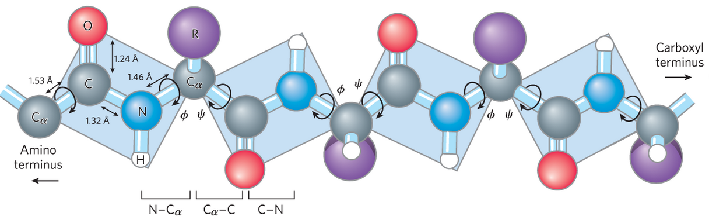
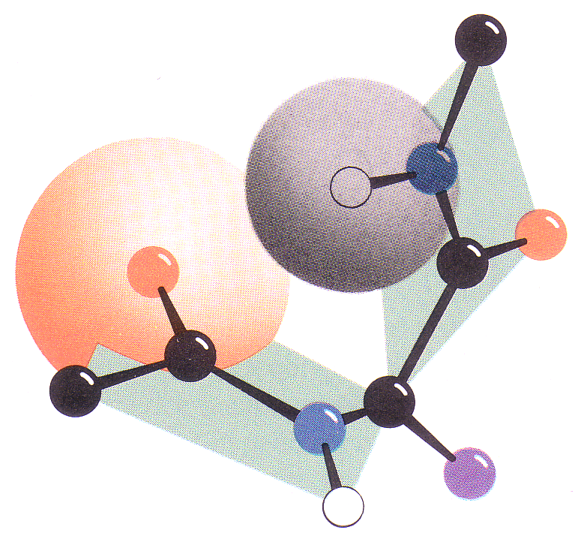
Peptide bond constraints plus finite size of atoms
Partial double bond
Backbone Torsion Angles
For fully extended polypeptide,
Φ = Ψ = 180º
Φ = Phi
Ψ = Psi
ω = Omega
main spine of backbone
Label with i-1, i, i+1 to keep track of residues close in AA sequence
C-Terminus
Shown: Because of real size of one H and one O, these φ, ψ shown are impossible!
α
i + 1
Do notice these single bonds that allow free rotation: Φ and Ψ
Peptide
plane
But what happens during “free rotation”?
N
ω
H
i + 1
i + 1
x
O
Entire planes of 6 atoms rotate as units
i - 1
C
O
i
i
Many combinations of φ and ψ cannot occur because of steric hindrance!
C
Ψ
Amino acid
residue
α
i - 1
α
i
i - 1
N
See the movie on our Canvas site: “Steric hindrance of a polypeptide”
i
Φ
R
N-Terminus
i
H
i

Slide 4
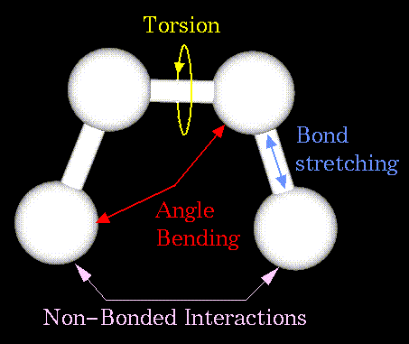
Torsion angle vs. bond angle
torsion angle Φ = Phi
N_{i}
C^{α}_{i}
C' means carbonyl C
bond
angle
C’_{i-1}
C’_{i}
“eclipsed” = 0°

Slide 5


+/- 180°
C’_{i}
torsion angle
Positive rotation
N_{i}
C^{α}_{i}
bond
angle
Right Hand
Rule!
C’_{i-1}

Slide 6
Steric hindrance: the real size of atoms, and the constraints around the peptide bond
α
i + 1
H
i + 1
i + 1
O
i - 1
i
i
We can keep track of which atoms have steric hindrance:
Ψ
1. Label all atoms of one AA as "i"
α
i - 1
α
i
2. All atoms of next AA closer to amino end are "i - 1"
i - 1
i
Φ
3. All atoms of next AA closer to carboxyl end are "i + 1"
i
i

Slide 7
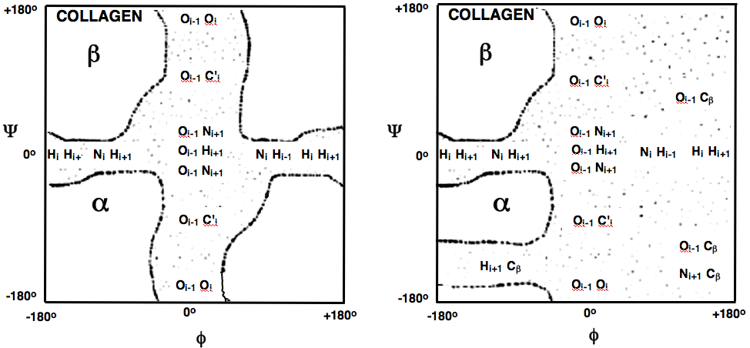
Ramachandran map: shows steric hindrance! AND
Main protein folding constraint
ALLOWED φ,ψ!
Define: φ and ψ = +/-180º means “fully extended” along peptide backbone
Stippled regions show the “prohibited” steric contacts
Cβ is the first carbon of a sidechain
Calculated for polyglycine
Calculated for polyalanine
ALLOWED = No steric hindrance
ALLOWED = No steric hindrance
ALLOWED = No steric hindrance
Cβ
Showing the atoms with steric hindrance
ALLOWED = No steric hindrance
ALLOWED = No steric hindrance
ALLOWED = No steric hindrance
Cβ
C' means carbonyl C
Cβ
Cβ
Much steric hindrance from just one Cβ compared with H
For a typical protein, only about 15% of possible Φ, Ψ combinations occur!
simple local steric hindrance strongly controls which protein structures are possible
Cβ is the main sidechain size influence on steric hindrance. Not much more hindrance for residues larger than CH3
This kind of steric hindrance is very local. Only atoms of an AA’s directly bonded neighbors!

Slide 8
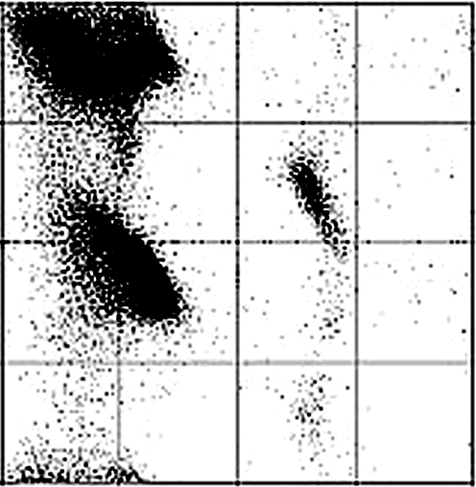
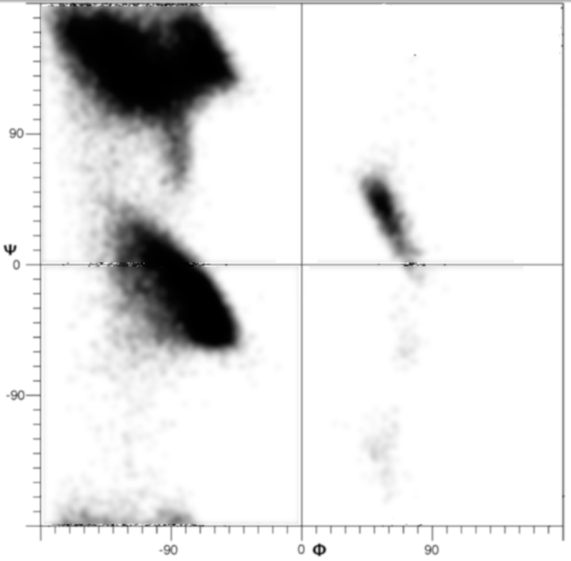
Ramachandran map: let's add more reality
Map calculated for poly(Ala). Allowed regions are "boxed"
Real data: plot of φ, ψ for a few hundred proteins
+180º
Equivalent to allowing a little steric contact, or small distortions of peptide bond so more φ,ψ angles are allowed.
atoms are hard spheres
atoms are smaller hard spheres
Ψ
0º
Observed (allowed)
Each dot is a φ, ψ pair for an amino acid residue in a real protein!
NOTE: Ramachandran map has NO SEQUENCE info!!!
-180º
All proteins: complete sequence of φ, ψ values defines 3D path of the polypeptide chain (but not the sidechain conformations!). Full 3D structure of one polypeptide chain is tertiary structure (“III”).
-180º
0º
+180º
φ
Gly ∴ allowed Φ,Ψ
Smaller runs of characteristic φ, ψ values are called secondary structure, abbreviated "II"
Given the 6 types of interactions, the peptide bond constraints, and the real size of atoms, only 4 types of recognizeable II structures are found:
A good guess of the Ramachandran map of a fully unfolded protein
α-helix, β-sheet, turns, and collagen (= polyPro type II helix!):
These all have φ, ψ values within the “no steric hindrance” regions

Slide 9
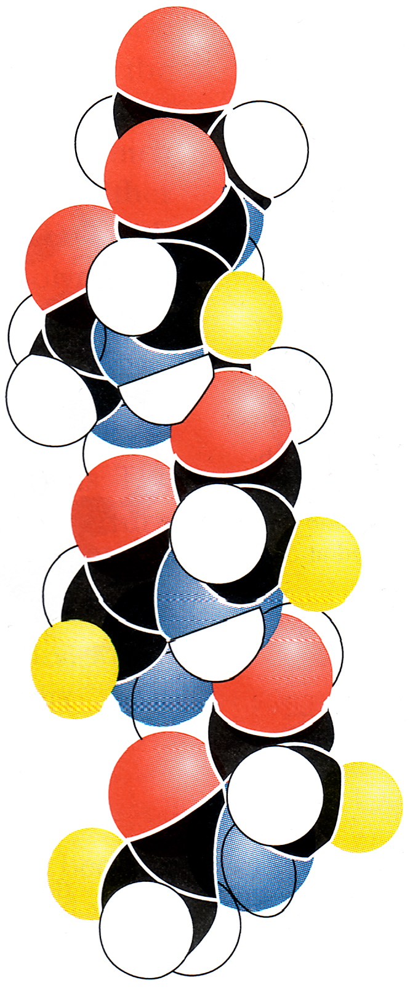
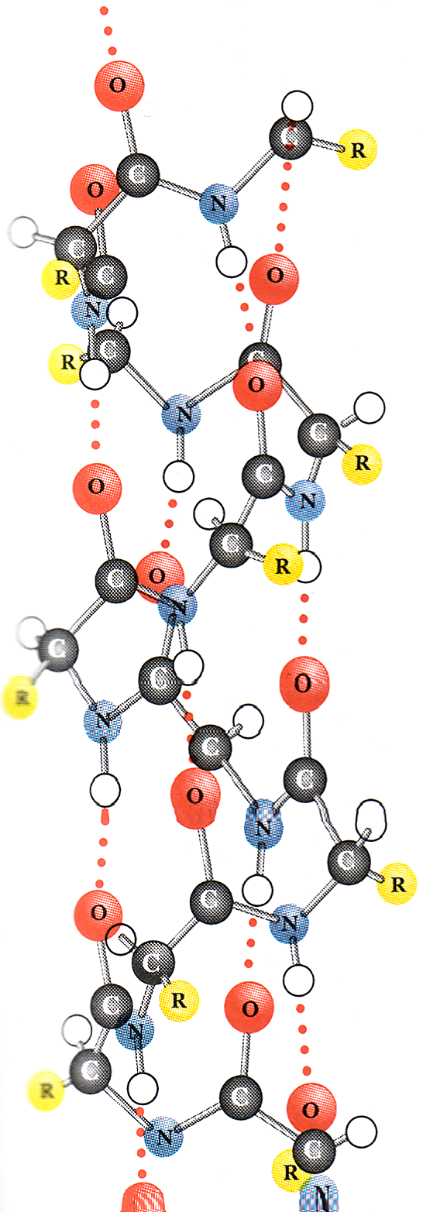
Secondary structure: α-helix
carboxy terminus
Repeating at least 5 AA: Φ ~ -60º, Ψ ~ -40º
PollEv Question!
R
α
5
α
α
5
4
R
5
α
4
3
5
R
α
3
4
2
3
4
α
2
R
3
1
α
R
2
2
1
α
1
Amino terminus

Slide 10
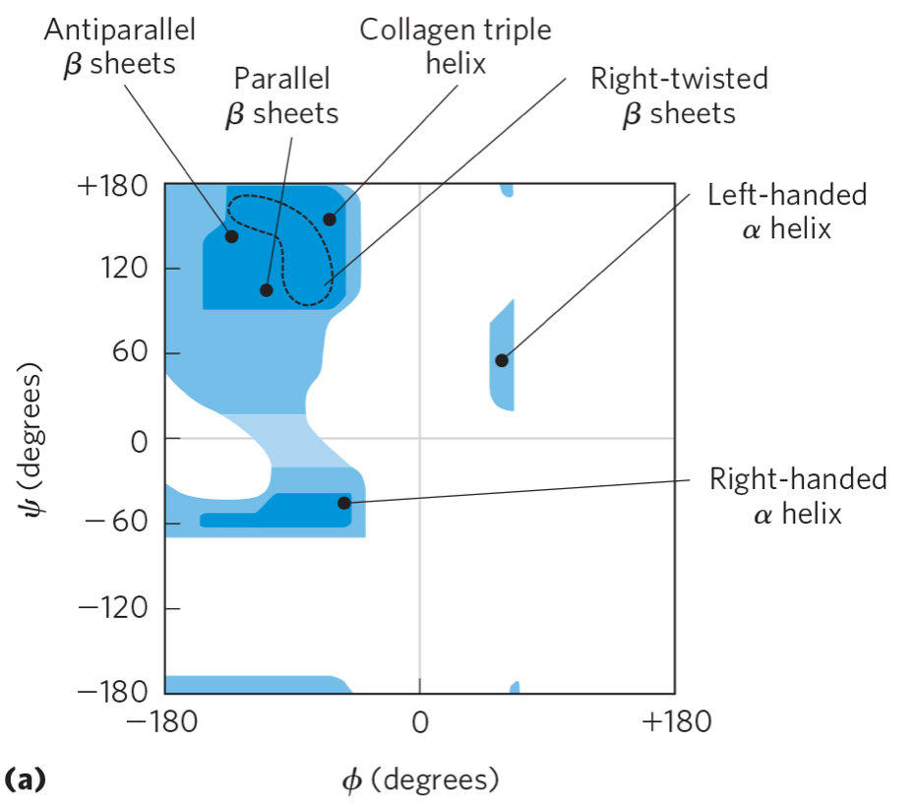
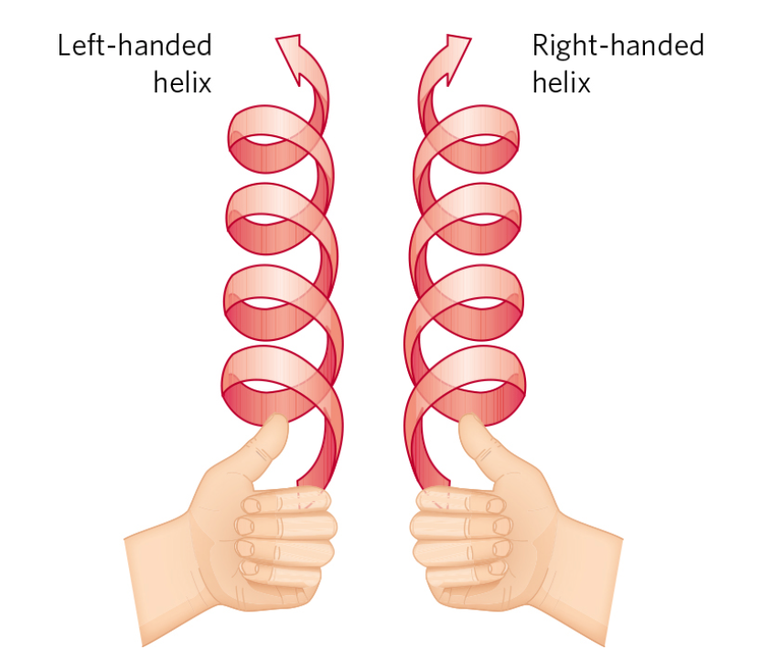

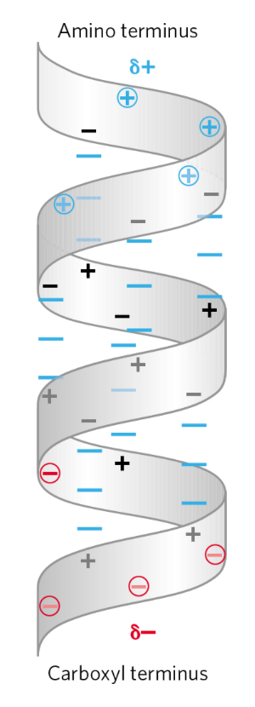
Secondary structure: α-helix
carboxy terminus
Repeating at least 5 AA: Φ ~ -60º, Ψ ~ -40º
Average length 10 - 11 AA residues
All R groups point away from helix axis
Every peptide carbonyl is acceptor for peptide N-H donor 4 AA away; But:
R
“End 4 AA” need other H-bond partners
α
Helix always right-handed
5
α
Represent helix as or
−60
α
5
4
R
5
−40
Which AA found in an α-helix?
α
4
Runs of positive or negative charge
3
5
are unfavorable;
R
α
3
4
AA vary in tendency to be in helix, e.g. Gly, Tyr, Asn, Lys, Ser in helix about 50% less often than Glu, Met, Ala, Leu.
And Pro almost never (but sometimes!)
2
3
4
α
2
R
3
1
α
R
2
2
1
α
~ all possible H-bonds are made
1
helix rotates 360º every 3.6 AA
Amino terminus

Slide 11
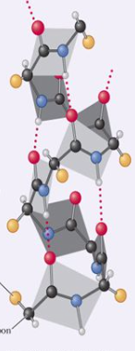
Peptide Plane Orientation: α-helix
All C=0 point in the same direction
All N-H point in the same direction

Slide 12
Proline special properties
Φ fixed at ~ -65º
N not H-bond donor
α
Ψ Cannot be near -40º because of steric hindrance with ring carbons
This peptide partial double bond can be either cis or trans
All other AA only trans

Slide 13
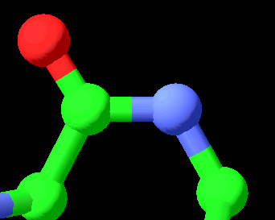
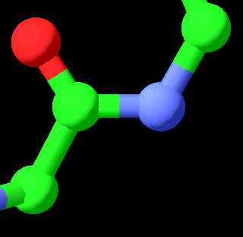
cis and trans isomers of the X-Pro peptide bond
ω = 0
δ
α
ω = 180
α
δ
cis
trans
Notes:
Let’s start with some basics first. Let’s consider a generic peptide bond between any two adjacent amino acids in a protein. This peptide bond is in the trans isomer state for all non-Pro amino acids because the cis isomer is much higher in energy than the trans, due to the less favorable interactions in the cis conformation. When the downstream amino acid is Proline, the peptide bond can adopt either cis or trans states because in either state, the delta CH2 group and the alpha carbon yield very similar steric constraints. Consequently, the relative energies of cis and trans states are much closer together for Proline than for all other amino acids.

Slide 14
Pro allows population of cis
X = Aromatic
residues
X-Pro
can be
~5 – 50% cis
in loops, tails,
unconstrained
peptides
trans for all
non-Pro
peptidyl prolyl isomerase enzymes accelerate cis-trans isomerization
Notes:
Here is what this looks like on an energy diagram. For all amino acid residues except proline, the trans state of the preceding peptide bond is much lower in energy than the cis, and we have a large difference in standard Gibbs free energy between cis and trans, which gives us effectively 100% trans population. For proline, the trans and cis states are much closer in energy, and the population of cis can be as high as about 50 percent in conformationally unconstrained parts of proteins such as loops and tails or small peptides; when X is tryptophan or another aromatic amino acid, this gives rise to the higher cis populations.
Importantly, the activation barrier for transition from trans to cis states is high (typically on the order of 14-24 kcal/mol), so that exchange between them is slow (with a time constant on the order of several minutes). Peptidyl prolyl isomerase enzymes accelerate this exchange by lowering the transition state barrier, bringing exchange time constants into the seconds-to-milliseconds timeframe of biological processes.
It is very important to note that a classical enzyme such as an isomerase does NOT change the equilibrium free energy difference between cis and trans states, i.e. the cis/trans ratio of the free substrate is not changed IF WE ARE AT EQUILIBRIUM. A classical enzyme can only ACCELERATE the achievement of equilibrium when the system is perturbed.

Slide 15
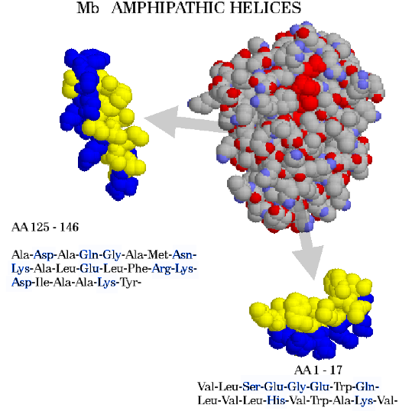
One way hydrophobic effect shows up: Amphipathic helices
Both Feeling
Color scheme: Blue - polar/charged
Mb
YELLOW - NONPOLAR
Helix turns 360º every 3.6 AA ∴ IF polar residues are spaced ~ every 3 - 4 AA, they are all on one side of the helix!
AA 125 - 146
Ala-Asp-Ala-Gln-Gly-Ala-Met-Asn- Lys-Ala-Leu-Glu-Leu-Phe-Arg-Lys- Asp-Ile-Ala-Ala-Lys-Tyr-
Amphipathic helices are on the protein surface. They follow the “rule of the hydrophobic interaction": Nonpolar residues are driven out of water, making the folded protein more stable
Evolution drives most proteins to become more stable
AA 1 - 17 Val-Leu-Ser-Glu-Gly-Glu-Trp-Gln-Leu-Val-Leu-His-Val-Trp-Ala-Lys-Val-

Slide 16
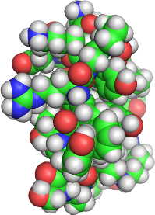
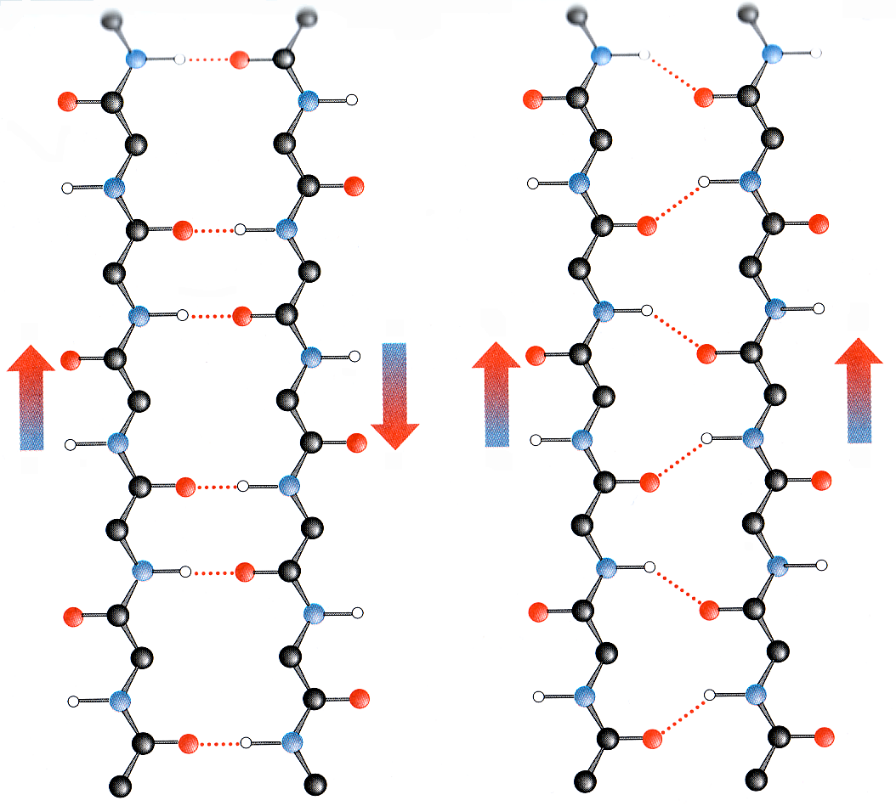
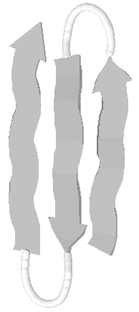
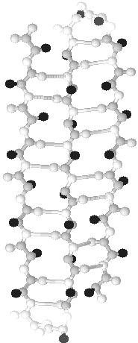


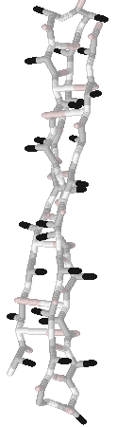

Secondary structure: β sheets
3-strand β-sheet "spheres"
φ ~ -60º to -150º, ψ ~ +90º to +180º repeating to yield a highly extended polypeptide chain.
Average strand length 6 AA, or ~ 20 Angstrom
C
N
C
C
Represent a strand
N
C
N
N
Runs of β-sheet are side-by-side strands, not continuous sequence
Strands have so-called “parallel” or else “anti-parallel” orientation
≡
All possible H-bonds are made between strands
3-strand β-sheet
Antiparallel
Parallel
Strands always distant in AA sequence
All R groups are either above or below the plane of the strands; they ALTERNATE above/below!


Strands are close in AA sequence





≡


β-sheet, edge view









Strands are distant in AA sequence







Slide 17
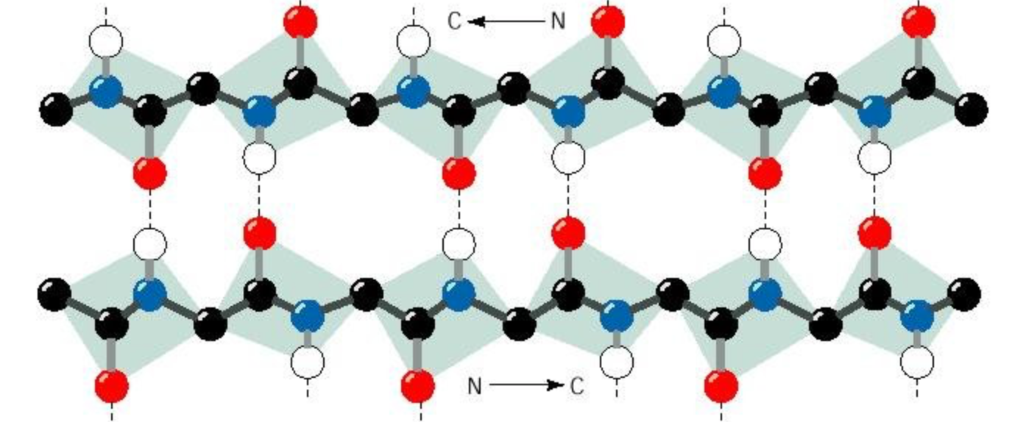
Peptide Plane Orientation: β-strand
C=0 alternate directions
N-H alternate
directions
Sidechains alternate
above/below the sheet

